Slide 1
AGENDA
1. Overview of Jenkins and CloudBees CI Capapbilities - Theory
2. Plugins Installation and Integration - Demo + theory
3. PipeLine fundamental ,Parameters, and Environment Variables Creation:(Decelrative Pipeline, Groovy Shared Library) Demo + theory
4. CloudBees CI enterprise Capapbilities (Pipeline template, Pipeline Policy and Configuration as Code) Theory
5. CloudBees CD/RO - Feature walkthrough - theory

Slide 2
Introduction to CloudBees Jenkins
CloudBees Jenkins is an enterprise-grade version of the popular open-source Jenkins automation server. It provides additional features and capabilities for managing and scaling Jenkins in large organizations.
Key Features and Benefits
CloudBees Jenkins offers enhanced security and access controls, allowing organizations to manage user permissions and ensure compliance with industry regulations.
It provides built-in support for distributed builds, enabling faster and more efficient build and test processes.
CloudBees CI allows users to easily create and configure CI pipelines using a visual interface. It provides a wide range of plugins and integrations to streamline the development and deployment process, enabling teams to automate their software delivery workflows efficiently.
CloudBees Jenkins also offers advanced analytics and reporting capabilities, providing insights into build performance and resource utilization.

Slide 3
Enhancing Jenkins for Enterprise Use
CloudBees extends the capabilities of Jenkins for enterprise use by providing:
Scalability and High Availability: CloudBees Jenkins allows organizations to scale their Jenkins infrastructure horizontally and vertically to meet the demands of large-scale CI/CD pipelines.
Advanced Security and Compliance: CloudBees Jenkins offers additional security features, such as role-based access control and integration with LDAP and Active Directory, to ensure the protection of sensitive data and compliance with regulatory requirements.
Enterprise Support and SLAs: CloudBees provides enterprise-level support and service level agreements (SLAs) to ensure the reliability and availability of Jenkins in mission-critical environments.

Slide 4
Additional Features and Add-ons
Additional Features and Add-ons
CloudBees offers a range of additional features and add-ons to enhance the functionality of Jenkins, including:
CloudBees Jenkins Advisor: A tool that provides recommendations for improving the performance, security, and stability of Jenkins instances.
CloudBees Jenkins Platform: A suite of plugins and integrations that extend the capabilities of Jenkins for specific use cases, such as container-based deployments and multi-branch pipeline management.
CloudBees Jenkins X: A cloud-native CI/CD solution that leverages Kubernetes and GitOps principles for automated application deployments.

Slide 5
Architecture

Slide 6
Jenkins Resources
Jenkins community blog
Jenkins project Wiki pages
Jenkins Subreddit
How to join the Jenkins community
Jenkins chats
Stackoverflow
Take a Jenkins training class
Follow the Jenkins project on Twitter

Slide 7
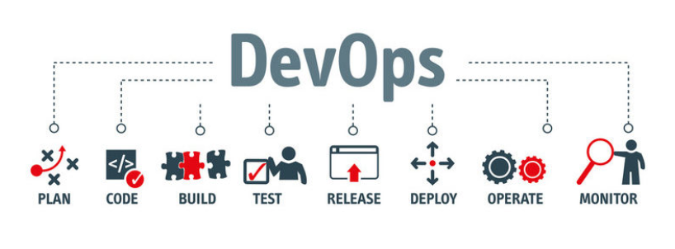
Jenkins projects
Types of Jenkins projects available right now..
Open source Jenkins
CloudBees Jenkins (CB Core)
Jenkins X

Slide 8
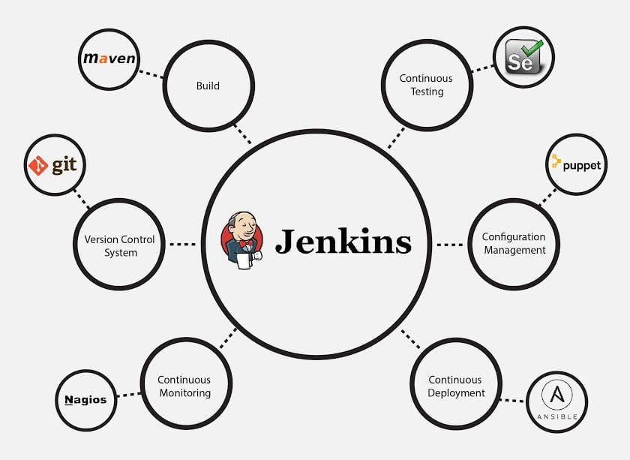
Jenkins overview
Jenkins 1.X
Jenkins is an open source automation server
with an unparalleled plugin ecosystem for delivery pipelines
Jenkins can automate
continuous integration
continuous delivery
something else entirely
Jenkins 2.0
Pipeline as code,
a new setup experience
and other UI improvements
Built-in support for delivery pipelines.
Improved usability.
Fully backwards compatible

Slide 9
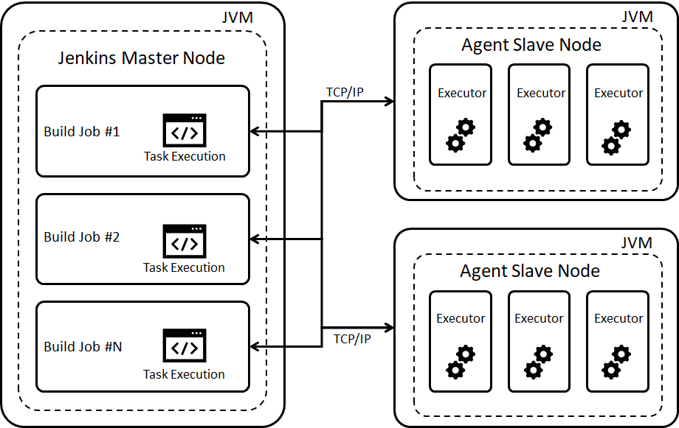
Jenkins Master Agent setup
Today we are going to see how to configure Jenkins master / Agent setup on GCP VM Instances which is based on debian.

Slide 10
Thank You!

